Slide 1


D2i GEELONG CITY
Product Owner Presentation
City of Greater Geelong Analytical Dashboard

Slide 2
PROJECT OVERVIEW
Machine Learning and Data Analytics Capstone Project – School of IT, Deakin University
Focused on solving real world problem and communicating data artefacts related to the City of Geelong’s Smart City initiative.
Working in close collaboration with Smart City Team, City of Greater Geelong Council

Slide 3
TEAM STRUCTURE
Team Member | Junior/Senior | Role
Srija | Senior | Data Analyst
Paul | Senior | ML Engineer
Vinayaka | Senior | ML Engineer
Omer | Senior | ML Engineer
Ngoc | Junior | ML Engineer
Shibendu | Junior | Data Analyst
Xiaoran | Junior | Full Stack Developer
Rishabh | Junior | Full Stack Developer
Yijia | Senior | Full Stack Developer
Anand | Senior | Full Stack Developer

Slide 4
SQUAD STRATEGY
Machine Learning
Research
Data Analytics and Modelling
Visualization
Web Development
ML model deployment
Designing UI
Content delivery
Agile Methodology
Scrum meetings
Regular meetings
Buddy system
Trello Board
Cross functional team

Slide 5
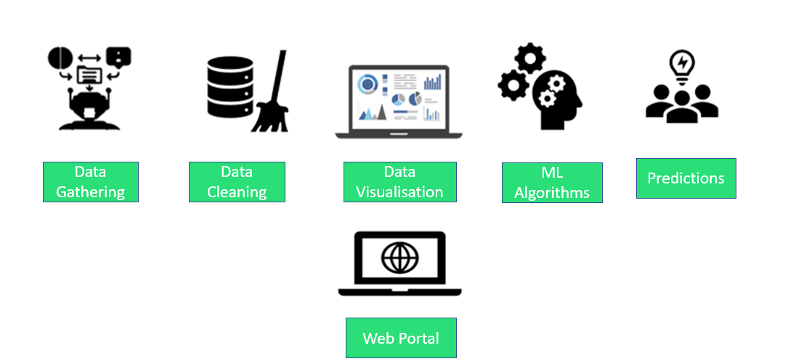
PROJECT DELIVERABLES T1 2021

Slide 6
PREVIOUS WORK
Geelong City Population Prediction
Insights from Crash data for Geelong
Visualizing insights from Real estate data and predicting the real estate price in Geelong
Crowd monitoring using Wi-Fi connected devices
Smart parking system data analytics
Web portal development

Slide 7
Key deliverables for T1 2021
Real Estate feature optimisation
Air Quality prediction from weather forecasts
Web portal unification
and live deployment

Slide 8
Air Quality Team

Slide 9
Air Quality Feature - Goals
Main target variable of PM₁₀ selected for prediction
Interesting relationships and correlations identified:
Exploratory data analysis for weather and air quality indexing has been completed.
Data exploration and Feature selection
Explored additional data from Barwon Health and Pollen grain count.
Investigated impact of bush fire data on Geelong AQI
Selected 4 predictor variables using feature selection (correlation).
Notes:
PM10 chosen because it includes particulate matter between 2.5 and 10 micrometers – pollen, dust, construction dust, wildfire particulates all fall into this category – inhalable and known to produce adverse health effects
Predictors chosen because:
The show good correlations to changes in PM10 measurements:
They are commonly provided in weather forecasting feeds – i.e. it will be easier to provide data to interrogate our model
Thuong provided feedback during the last studio session: Justify the decisions we make what are the strengths and weaknesses we are addressing
Health data: Barwon health require an ethics submission and for someone from Barwon health to be invited to participate – this is not unusual, however our project has very specific and tight time targets which we would be unlikely to meet if we formalised the process.
Victorian bushfire data: have explored access through Forest Fire Management Victoria, no response as yet, aggregate data, statistics, maps and broad date ranges are available from various sources and news reporting. Alternative would be to construct a dataset to flag dates and approximate locations ourselves, however we again run into time constraints.
Vic pollen count data: We have approached the Deakin academics responsible for pollen counts in Geelong – no response as yet
Summary: none of these data sources were essential to working towards our main project goals for the AQ analysis, however they could add value and depth to our analytics – disappointing, but we can still achieve our goals

Slide 10
Air Quality Feature – Modelling Technique
Machine Learning Models
Built machine learning and deep learning models that forecasts the PM10 values.
Random Forest Regression
Stochastic Gradient Descent Regression
Support Vector Machines
K Nearest Neighbour Regressor
MLP Regressor
LSTM model
Bi-LSTM neural network model
GRU neural network model
Attention based LSTM neural network model
Facebook Prophet Model
XGBoost Regression
Gradient Boosting Regressor
Chose Support Vector machines model due to low RMSE values
Logistic Regression
Notes:
Thuong provided feedback during the last studio session: Justify the decisions we make what are the strengths and weaknesses we are addressing
Health data: Barwon health require an ethics submission and for someone from Barwon health to be invited to participate – this is not unusual, however our project has very specific and tight time targets which we would be unlikely to meet if we formalised the process.
Victorian bushfire data: have explored access through Forest Fire Management Victoria, no response as yet, aggregate data, statistics, maps and broad date ranges are available from various sources and news reporting. Alternative would be to construct a dataset to flag dates and approximate locations ourselves, however we again run into time constraints.
Vic pollen count data: We have approached the Deakin academics responsible for pollen counts in Geelong – no response as yet
Summary: none of these data sources were essential to working towards our main project goals for the AQ analysis, however they could add value and depth to our analytics – disappointing, but we can still achieve our goals

Slide 11
Air Quality Feature – Best Model
Best Model - Parameters
Support Vector Machine – optimal model with less RMSE score of 6.08
Model | Input Features | Parameters
Support Vector Machines | Maximum daily temperature Rainfall Speed of maximum wind gust Direction of maximum wind gust | Kernel : ‘rbf’, C : 0.1 Epsilon : 0.01 Gamma : 0.1
Table : Best model parameters

Slide 12
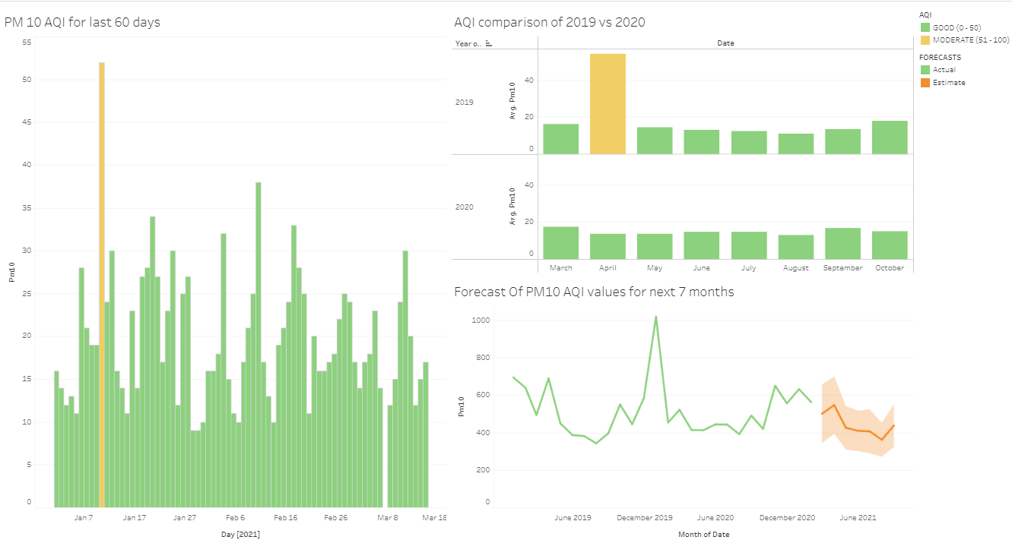
Current Dashboard (AQ Feature)

Slide 13
Real Estate Team

Slide 14
Real Estate Feature Goals
Goals For Trimester
Optimize the existing Neural Network model
Use other Machine Learning algorithms
Visualize the impact of Covid-19 to the house price in Geelong

Slide 15
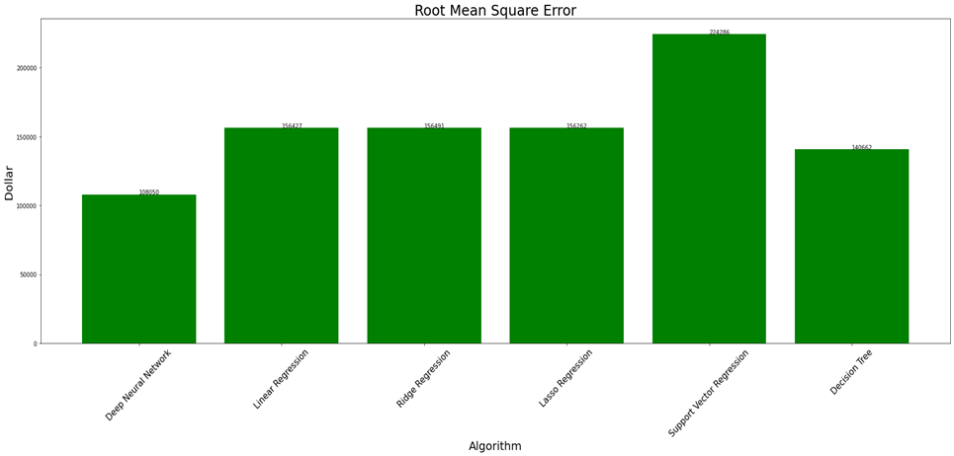
Real Estate Feature – Modelling Techniques
Machine Learning model
Predict house prices in Geelong
Result:
6 algorithms:
Linear Regression
Ridge Regression
Lasso Regression
Support Vector Regression
Decision tree
Root Mean Square Error (RMSE) is metric.
Deep Neural Network (DNN)
DNN is the best model because it reaches the lowest RMSE value.

Slide 16
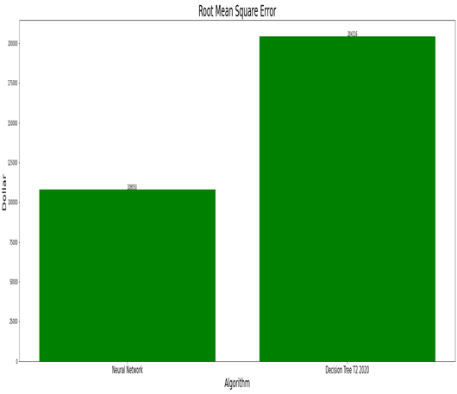
Real Estate Feature – Best Model
The optimal Neural Network model
Results:
13 inputs feature: Suburb, Land Size SQM, Bedrooms, Toilet, Car, School, Shop, Station, Park, Hospital, Rent Amount, Auction, Last Sell Price
Single node output
Optimiser (Adam)
Learning rate (0.01)
Drop-out rate (0.5)
Weight Decay regulizer
Epochs (46)
50% reduction in RMSE compared to T2 2020 model
3 hidden layers (128, 256, 128 nodes)

Slide 17
Real Estate Feature - Visualizations
Visualization
Our visualizations include:
Median Facilities of in Geelong.
Visualize the Median House Price and Number of Covid-19 Cases in Geelong for the last 2 years.
Median House Price and Number of Lockdown days in Geelong
Prediction of the average house price in Geelong.
Visualize the impact of lockdown on house prices in Geelong.
The Map and Ranking of Average Selling Prices of suburbs in Geelong.

Slide 18
Web Team Update

Slide 19
Web Development Goals
Goals identified for this trimester
Tableau Report Integration for analytics
Unified Dashboard for features developed by D2I Geelong City
Optimize user interface for smoother interaction
Access to live website
User interface for ML features
Infrastructure for prediction service

Slide 20
Web Development Goals - Achieved
Developed infrastructure for prediction service
Migrated features Wi-Fi and Parking Data Analysis to single website
Deployed website and prediction application on Heroku
Goals achieved in this trimester
Completed ground work for deployment on GCP
Developed UI for real estate and AQI features
Integrated updated tableau reports for analytics
Integrated Google Places API to search nearby places for real-estate model

Slide 21
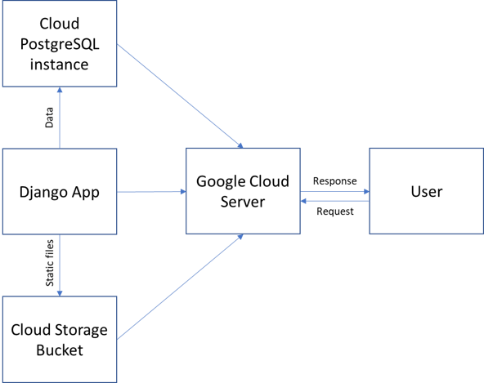
Machine Learning Model & Website Deployment – GCP (Researched)
Model Deployment Approach
Deploy custom model on GCP AI Platform
Endpoint integration into Django application
Endpoint Creation for model deployment
Website Deployment Approach
Create storage bucket for static files.
Create PostgreSQL database instance for data storage.
Modify Django app configuration settings to point to GCP

Slide 22
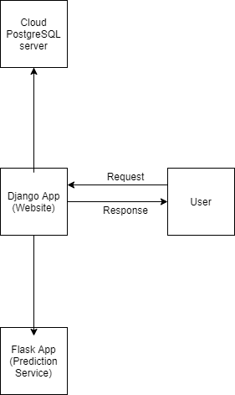
Machine Learning Model & Website Deployment – Heroku (Implemented)
Model Deployment Approach
Deployed custom model on Heroku Platform
Created Endpoint for prediction from model using Flask
Website Deployment Approach
Endpoint integrated into Django application for rendering results
Integrated Heroku PostgreSQL database instance for data storage
Deployed website on Heroku platform

Slide 23
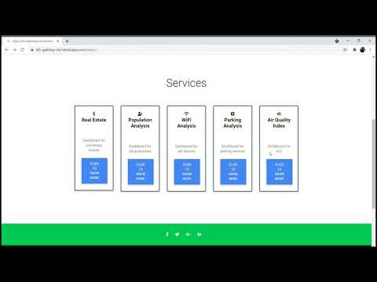
Demo

Slide 24
Plan For Next Trimester
Machine Learning Team (AQ and RE)
For Air quality feature - Exploration of few more visualisations and integration of final tableau dashboard into Air quality prediction web page.
For Real Estate feature - Add more data and add more features by google API & improve predictions.
Build data pipelines for ingestion and prediction
Build Deeper neural network and other models to reduce RMSE. Explore more visualizations on Tableau.
Predict future price of housing unit based on the council investment like opening new shopping centres, parks in the suburbs

Slide 25
Plan For Next Trimester
Web Development Team
Finalize text content for existing webpages to prepare website to be hosted in a live environment
Finalize deployment service as per instruction from University / DISC team
Provide beta access to client in order to receive and incorporate feedback
Build prediction services for the integration into client applications
Minimize the page load time

Slide 26
We love feedback!

Slide 27
Thank You!

